Slide 1
Weekly Update 1
Sarang Deb Saha

Slide 2
Datasets Evaluated:
UK Car Accidents 2005-2015
Accidents in France from 2005 to 2016

Slide 3

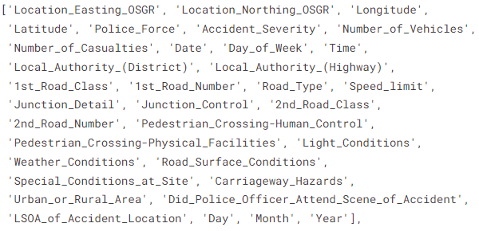
UK Car Accidents 2005-2015
https://www.data.gov.uk/dataset/cb7ae6f0-4be6-4935-9277-47e5ce24a11f/road-safety-data

Slide 4
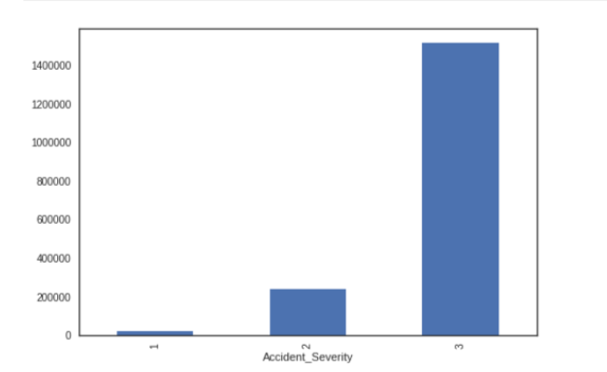
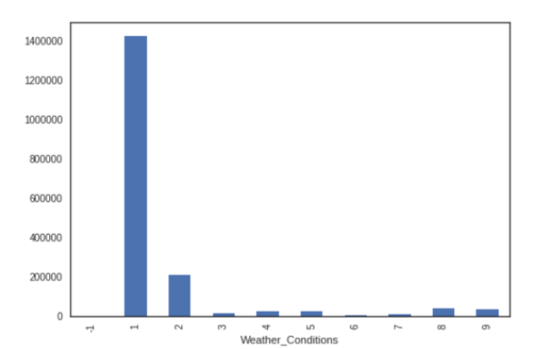
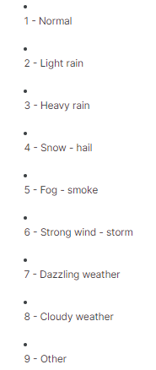
fg
1: Serious/Fatal Accidents
2: Mildly Serious Accidents
3: Less Serious Accidents

Slide 5
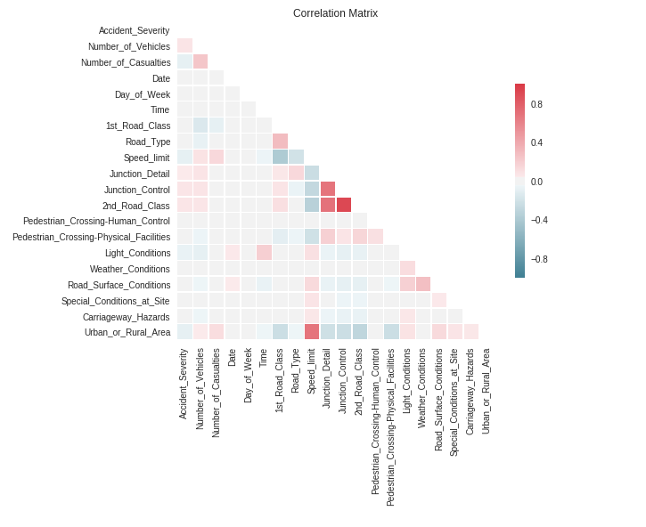

Slide 6
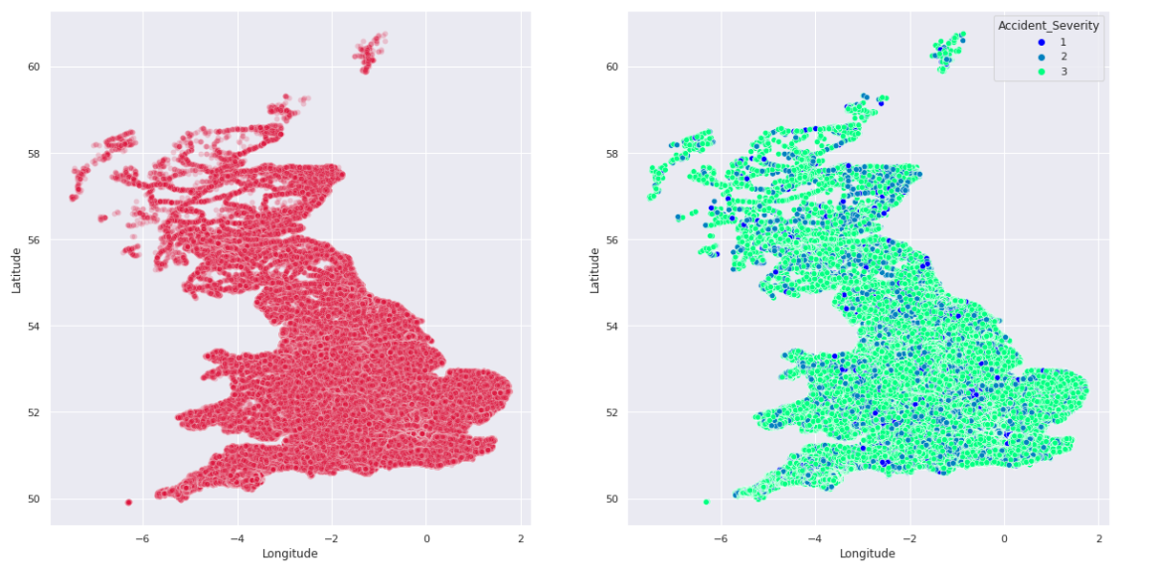
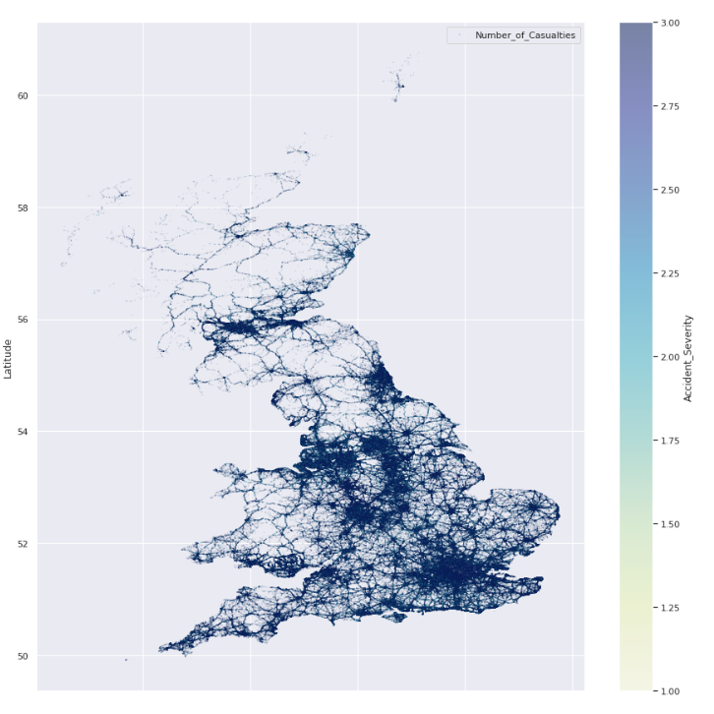

Slide 7

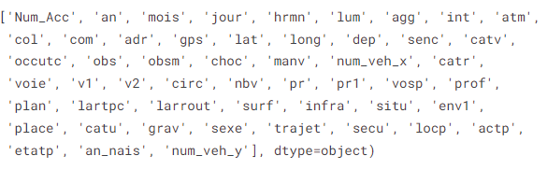
2. Accidents in France from 2005 to 2016
Number of accidents in France have steadily decreased from 2005 to 2013, but an increasing trend is observed from 2013 to 2016.
In this dataset, 2005 had the largest number of accidents equal to 374561.

Slide 8
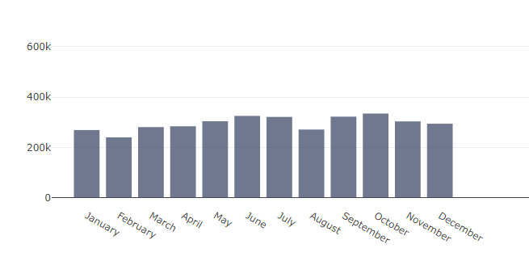
June, July, September, October have the highest number of accidents, while February has the lowest.
On an average about 296,164 accidents occur every month in France.
October has the highest number of accidents (with about 334,884 incidents) than any other month
Weather in France during September and October is cold and wet whereas, June and July form the peak tourist season

Slide 9
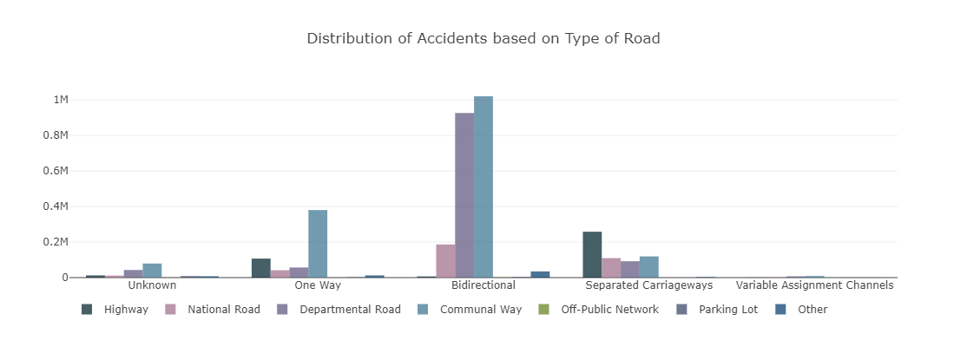

Slide 10
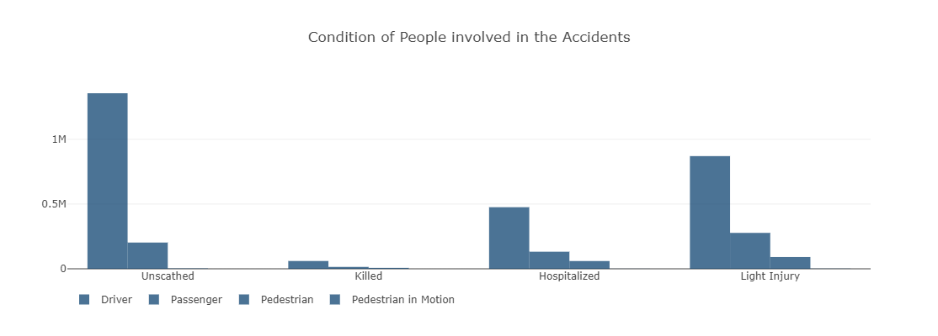
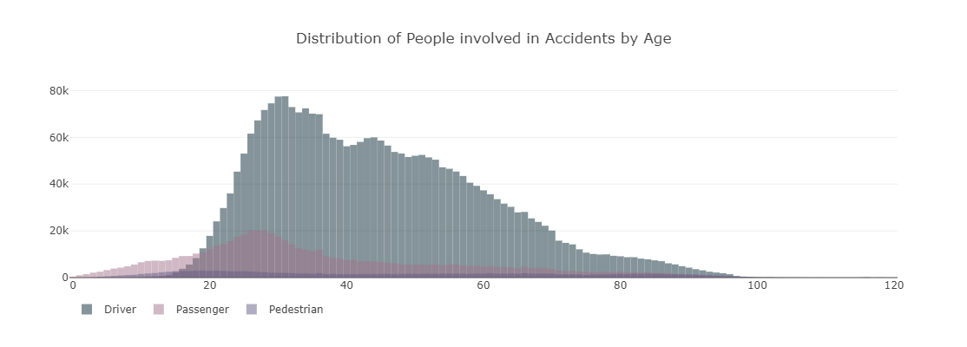

Slide 11

Other data sources:

Slide 12
Papers referred this week:
Khanum, H., Garg, A. and Faheem, M.I., 2023. Accident severity prediction modeling for road safety using random forest algorithm: an analysis of Indian highways. F1000Research, 12, p.494.
Ahmed, S., Hossain, M.A., Ray, S.K., Bhuiyan, M.M.I. and Sabuj, S.R., 2023. A study on road accident prediction and contributing factors using explainable machine learning models: analysis and performance. Transportation research interdisciplinary perspectives, 19, p.100814.
Karamanlis, I., Nikiforiadis, A., Botzoris, G., Kokkalis, A. and Basbas, S., 2023. Towards Sustainable Transportation: The Role of Black Spot Analysis in Improving Road Safety. Sustainability, 15(19), p.14478.
Cui, H., Dong, J., Zhu, M., Li, X. and Wang, Q., 2022. Identifying accident black spots based on the accident spacing distribution. Journal of traffic and transportation engineering (English edition), 9(6), pp.1017-1026.

Slide 13
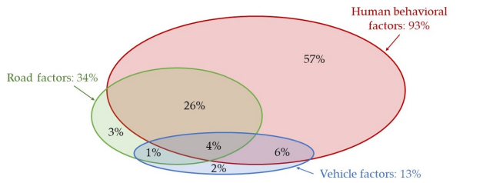
Towards Sustainable Transportation: The Role of Black Spot Analysis in Improving Road Safety. Sustainability

Slide 14
Smeed’s Equation
D/P = 0.0003 (N/P)^0.33 (1)
or
D/N = 0.0003 (N/P)^−0.67 (2)
wherein:
D is the number of reported road deaths in a year;
N is the number of registered vehicles;
P is the population of the country to which the Smeed equation is applied;
D is the dependent variable and both the number of vehicles and the population of
the country are the independent ones. The two equations above, which indicate that the
fatality rate of road accidents in a country is directly related to the rate of increase in using
motor vehicles, are considered primitive nowadays.

Slide 15
The most common and widely used methods of finding black spots are the following:
• The method of accident rate;
• The method of gravity rate (index);
• The method of random Poisson distribution;
• The Bayes method;
• The method of quality control

Slide 16
THANK YOU!

